Slide 1
Diagnosis of Process condition with Pattern Recognition
Problem type: Regression and Classification

Slide 2

For Onshore Well the Oil Pump, called Sucker Rod Pump extract oil from subsurface reservoir. At the subsurface monitoring, the process is expensive, complex and erroneous
The current monitoring is image based and requires continuous monitoring by Human
Due to manual processing its not all the time possible to monitor continuously
Problem Statement
Continuous monitoring of Downhole condition
Detect mechanical condition and operation condition from the down hole meter data
Based on condition sent alert.

Slide 3
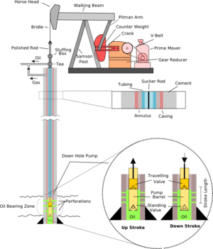
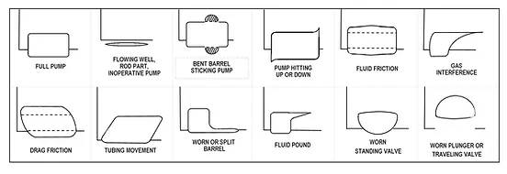
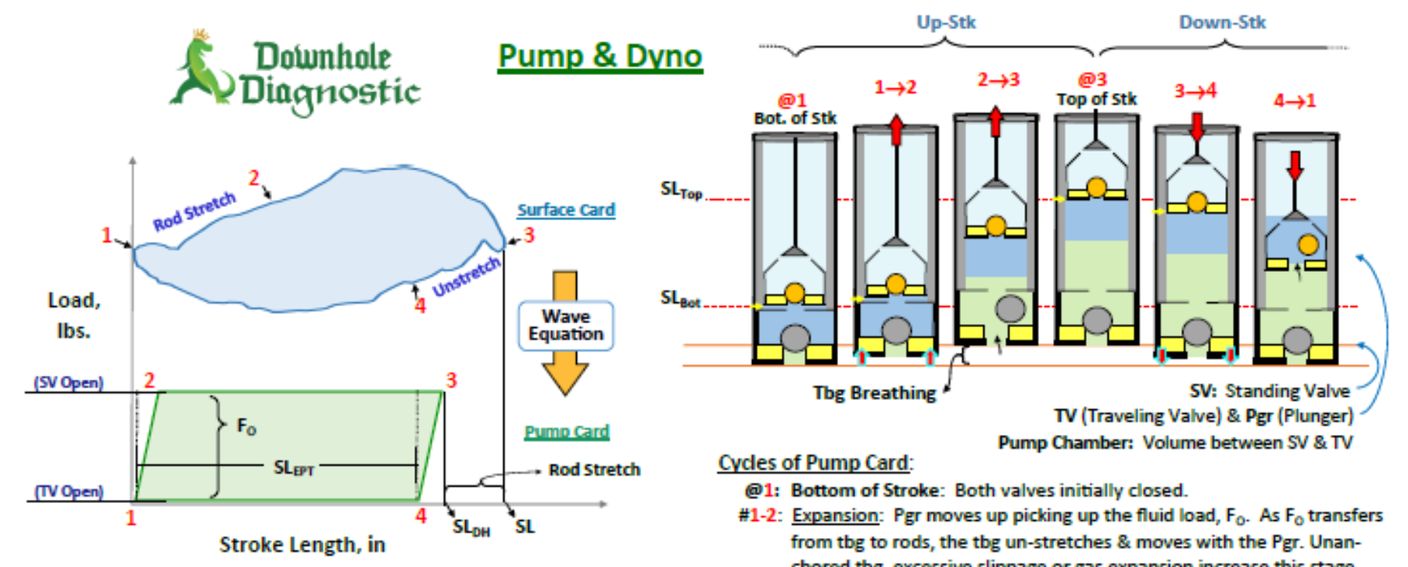
How Sucker rod Pump Extract Oil from Subsurface

Slide 4
Water Quality History Data.
Chloramines: Chlorine and chloramine are the major disinfectants used in public water systems. Upto 4mg/liter is safe
Organic_carbon: Total Organic Carbon (TOC) in source waters comes from decaying natural organic matter (NOM)
Trihalomethanes: THMs are chemicals which may be found in water treated with chlorine. 80ppm is safe.
Potability:
Indicates if water is safe for human consumption where 1 means Potable and 0 means Not potable.

Slide 5

So lets Run with a Robot AI…..

Slide 6
Get the Decision with 4 Steps
Create a Solution Name “Oil Well Process”→ solution type: Regression→ Click create solution
Data
Upload Process_Diag_with_Pat_Recog_Train.csv data
A variable list will show up→ click on skip
Go to Data Preprocessing
Click on pattern recognition
Select Known Pattern
Select Graphcard_CardDhole as Column to be labeled
In Data format, select patterns in Discrete cells
In Data schema Cell: type : Load;Disp|
In known patterns upload known_patterns.CV
For Known pattern column: GraphCard_CardDhole
For Pattern Label Column select Diagnosis
Z-score Normalization = Yes
Match Type: Best Match
Click Apply
Check pattern detail and pattern summary
Edit, Match type with Threshold = 90%
No. of Unknown group 10
Try with beginning with Unknown pattern
Select Graphcard_CardDhole as Column to be labeled
Patterns in discrete cells
Put Data schema Load;Disp|
No. of Groups = 10
Click Apply
Select target. Choose “Pump Fillage” as your target

Slide 7
Get the decision with 4 steps
Build Model
Deploy
Select Variables
Uncheck variable System RTU, Graphcard_CardDhole, Graphcard_cardsurf
Select Algorithm
Click on Train
Click on Finalize
You will land on Deploy page
Click on Add data→
upload new data from CSV source from you computer milk_quality_pred.csv file
A variable list will show up→ click on skip
Data Postprocess Create equation
Alert: np.where(df[“GraphCard_CardDhole_label” == “Normal” & df[“Pump_Fillage”]< 70, “Abnormal Operation Check Immediately”, “Safe Operation”)
Go to Result Configuration
Check download as CSV
Select Algorithm
Press “Predict”,
Press Next→ you will land in Decision Page
Decision
Select Decision Scenario Tab
Change slider value for different variables
Press Apply
Do the step until Target or Target desired value is higher or lower or middle

Slide 8


